Slide 1
Portfolio Website in Front-end
- NITIN PAL ( 21MCA2514 ) & Gourav (21mca2463)

Slide 2

About Portfolio Website
The objective of this project is to build a Portfolio Website in Front-end. In this Front-end project, It provides a convenient way for potential clients to view your work while also allowing you to expand on your skills and services.

Slide 3
Project Prerequisites
To build the portfolio website project we used the HTML, CSS and VS Code.
HTML (Hyper Text Markup Language) is the language for describing the structure of Web pages.
CSS (Cascading Style Sheet) is a style sheet language used for describing the presentation of a document written in a markup language such as HTML.
VS-Code(Visual Studio Code) also commonly referred to as VS Code, is a source-code editor made by Microsoft for Windows, Linux and macOS.

Slide 4
Project File Structure
STEPS TO BUILD A PORTFOLIO WEBSITES PROJECT:
Plan your layout
Add specific styles using CSS
Add colors and backgrounds
Create the element in your layout
Boilerplate code

Slide 5
1. Plan your layout
The first step of any websites is always to know what on it and how you want it to look. So, the first step is to do a rough sketch – either on paper or on the computer, depending on which you find easier.

Slide 6
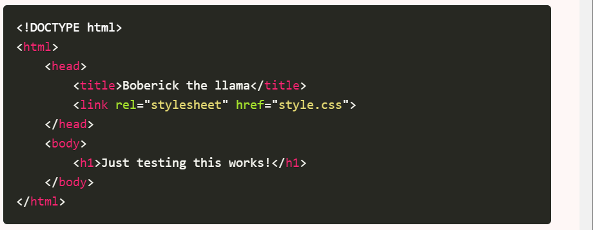
2. Boilerplate Code
It’s time to get the basic code that you have at the of any websites (this is commonly called the boilerplate).
Creating a new folder on your computer for the website.
Create new empty index.html and style.css files inside.
Add the basic ‘boilerplate code’ to your index.html file

Slide 7
3. Create the element in your layout
It’s time to create the layout/section elements that you planned in step 1. The best way to do this by using semantic elements: <header>, <main>,<section>,and <footer>.
Once you have the section of the page, fill them up! If you know what content you are going to be using, put that in. If not, put in some dummy text and replace it with the actual content later.

Slide 8
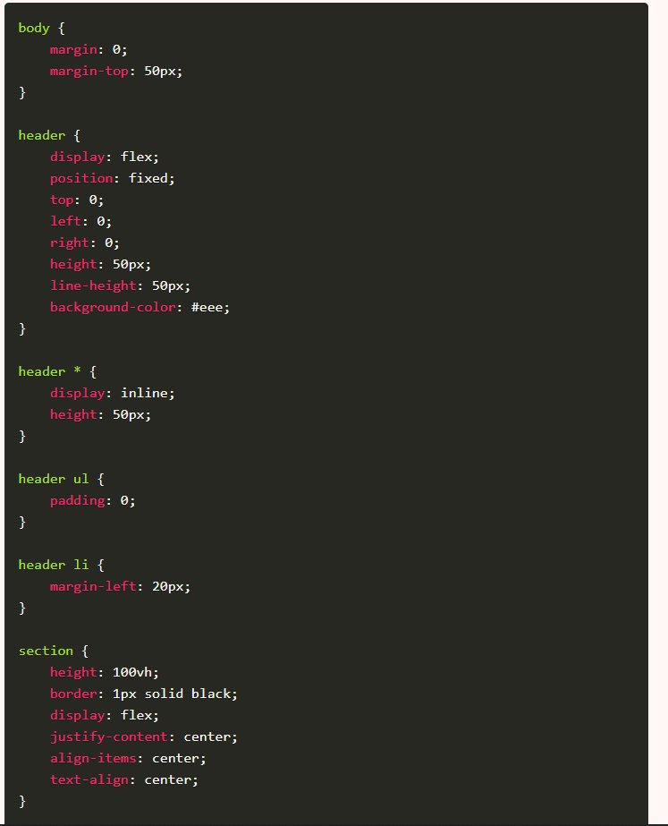
4. Add specific styles using CSS
Once we’re done with our HTML, it’s time to move on to CSS. The first and most important part to focus on first is to get it looking like our layout – then we can focus on the details.
This means that we need to focus on properties like width, height, padding, position, and display. Also, we need to make sure the images are the right size so that they don’t obliterate the page.

Slide 9
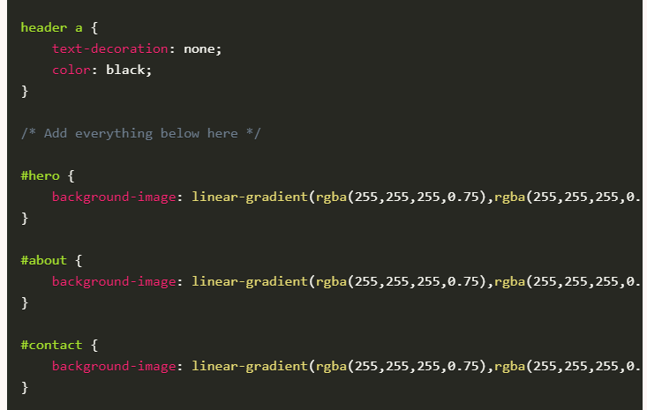
5. Add colors and backgrounds
We’re on the home stretch now. It’s time to add the finishing touches to our websites – colors and backgrounds.
This is what will make our site look really awesome.

Slide 10
Summary
I successfully developed Portfolio Website project in front-end. I learn how to used tags , elements and tags. I also learn more about HTML and CSS.

Slide 11
Thank You

